Slide 1

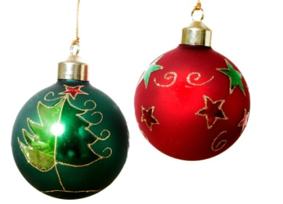


Christmas Buffet
£19.95 per head
Brie Bites
Spicy fruit chutney (V)
Vegetable Gyoza
Chilli mango dip (VG)
Cocktail Sausages
Honey mustard sauce
Beer battered onion rings
Smoky chipotle mayo, cajun salt (V)
Smoked haddock and leek croquettes
Lemon and dill crème fraiche
Crispy chicken tender
Sweet chilli dip
The Porterhouse
21-22 Maiden Lane,
London, WC2E 7NA
Tel - 020 7379 7917
E-mail: enquiries@porterhouse.london
A 12.5% service charge will be added to all bills

